Slide 1
Weekly report: Tower structure
Week number: 10
Date: 02/12/2025
Supervisor: Prof. Faber
Group members: Ibrahim Mostafa, Mohammed Eldemerdash, Kirollos Ghaly
Speaker: Ibrahim Mostafa(770134)
02/12/2025
1
Speaker: Ibrahim Mostafa (770134)
Tower structure team/ Optimus Syria

Slide 2
List of contents
Recalculation of the Eigenfrequency, Campbell diagram with the operational range
Design the flange connection
The next task
References
02/12/2025
2
Speaker: Ibrahim Mostafa (770134)
Tower structure team/ Optimus Syria

Slide 3
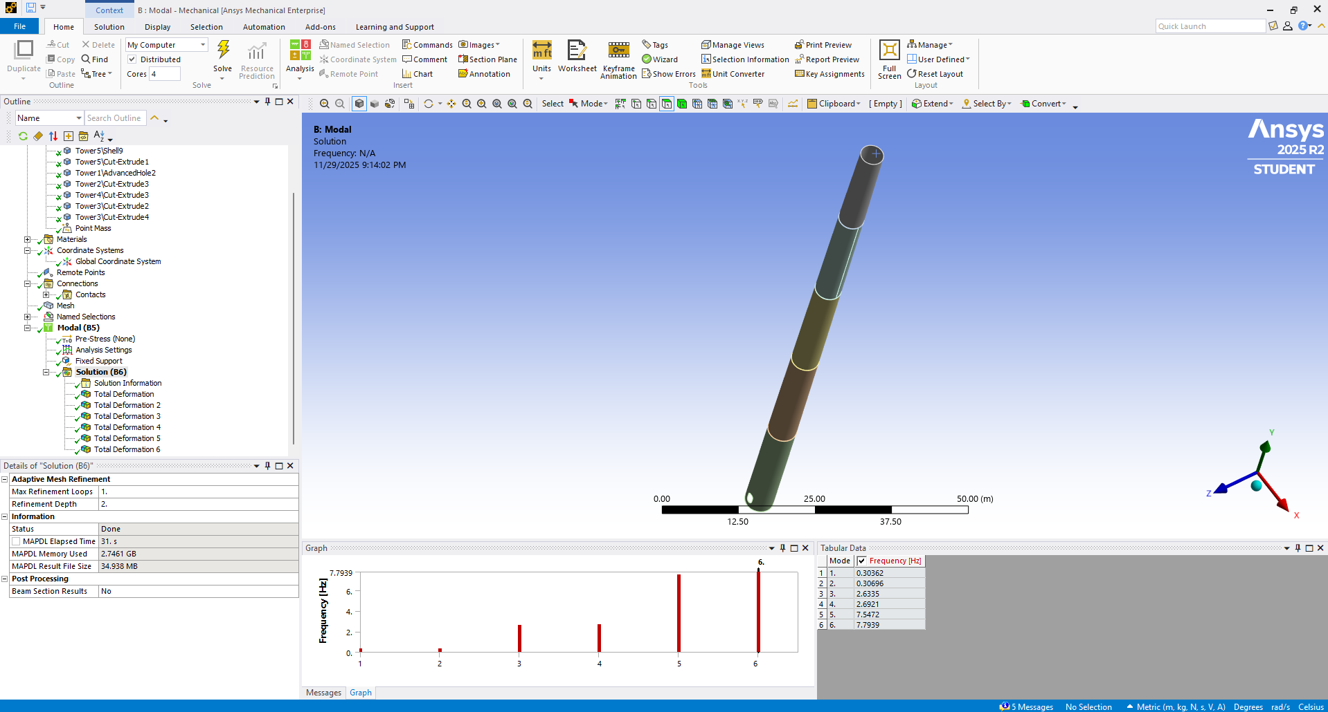
Calculation of the Eigenfrequency
Fig : calculation of the eigen frequency using Ansys
02/12/2025
3
Speaker: Ibrahim Mostafa (770134)
Tower structure team/ Optimus Syria

Slide 4
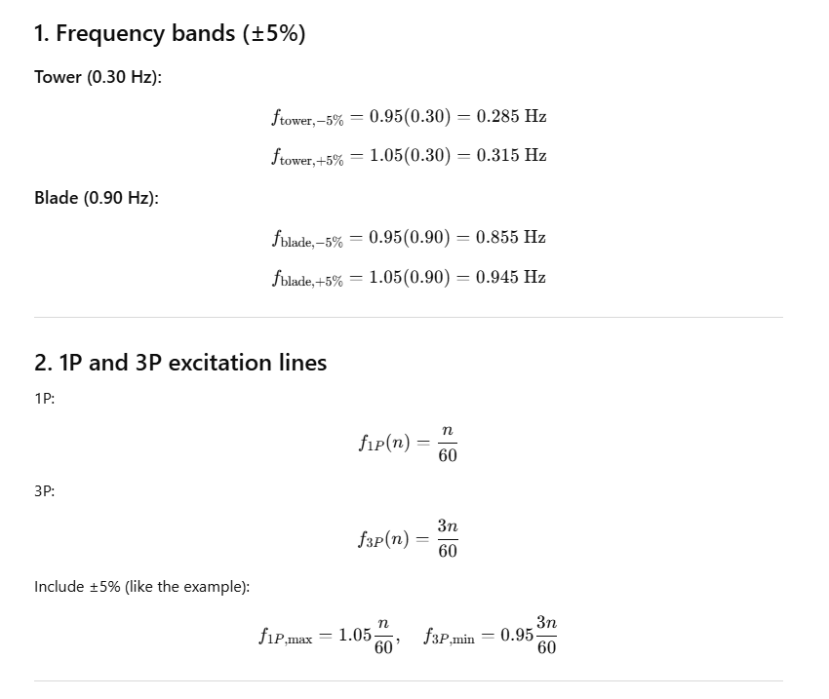
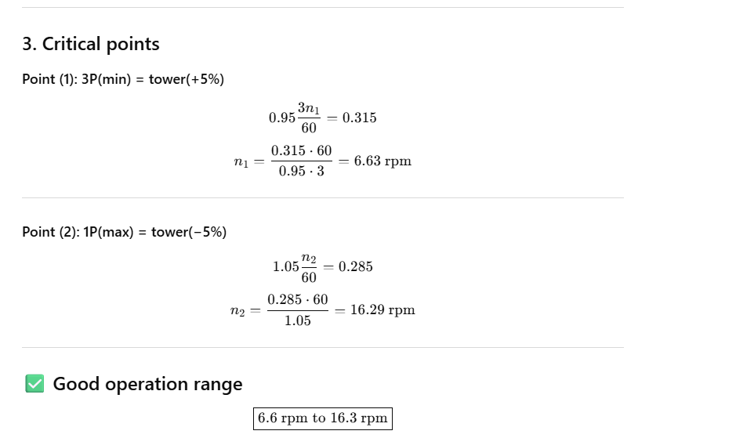
Campbell diagram
02/12/2025
4
Speaker: Ibrahim Mostafa (770134)
Tower structure team/ Optimus Syria

Slide 5
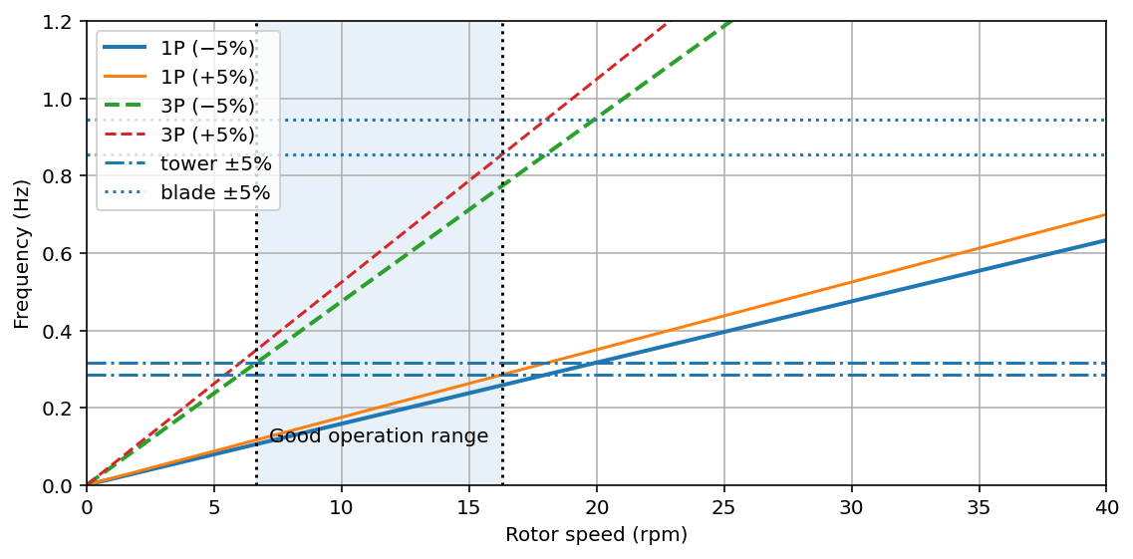
Campbell diagram
This is according to SI calculations
6.6
16.3
6.7
10.65
Fig : operational range of the rotor on campbell diagram
02/12/2025
5
Speaker: Ibrahim Mostafa (770134)
Tower structure team/ Optimus Syria

Slide 6
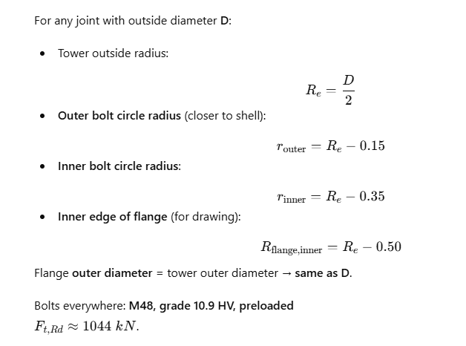
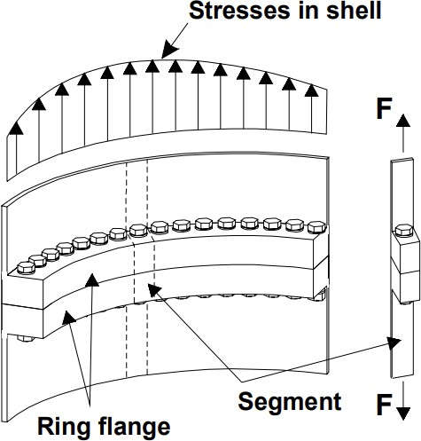
Design the flange connection
Source: Prof. Dr.-Ing. Torsten Faber lectures
18/11/2025
6
Speaker: Mohammed Eldemerdash (760137)
Tower structure team/ Optimus Syria

Slide 7
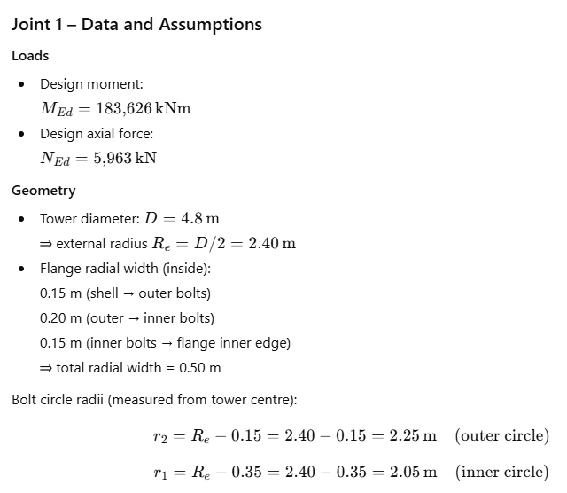
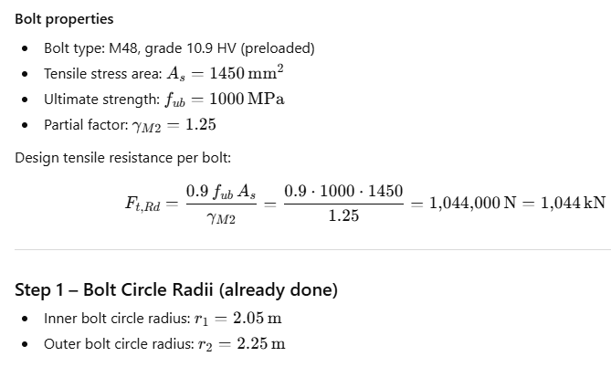
Design the flange connection
02/12/2025
7
Speaker: Ibrahim Mostafa (770134)
Tower structure team/ Optimus Syria

Slide 8
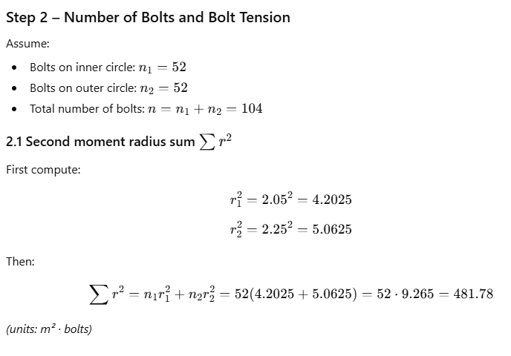
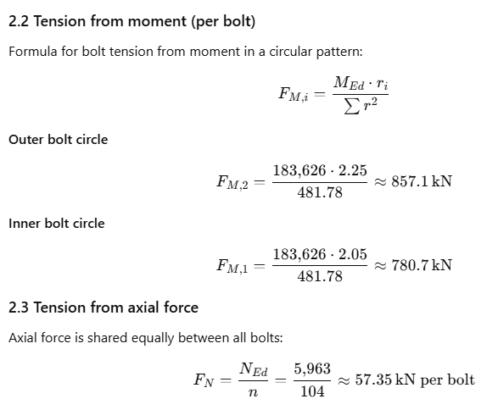
Design the flange connection
02/12/2025
8
Speaker: Ibrahim Mostafa (770134)
Tower structure team/ Optimus Syria

Slide 9
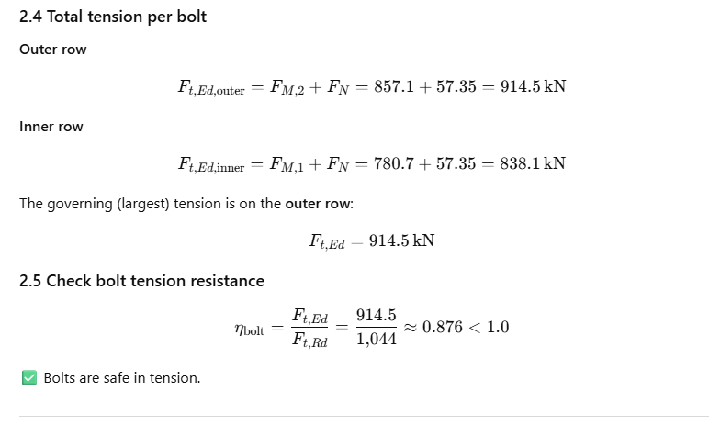
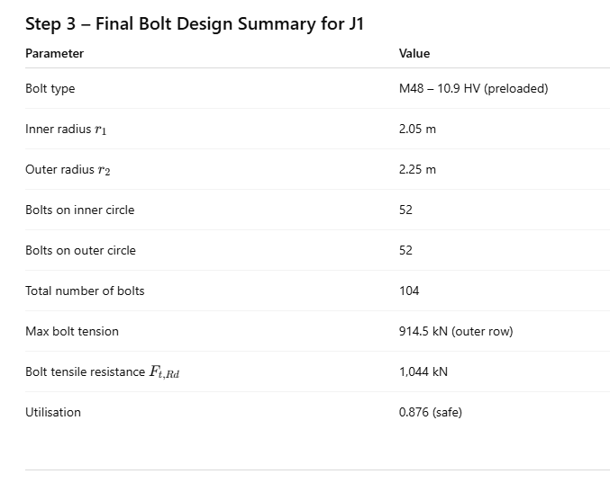
Design the flange connection
02/12/2025
9
Speaker: Ibrahim Mostafa (770134)
Tower structure team/ Optimus Syria

Slide 10
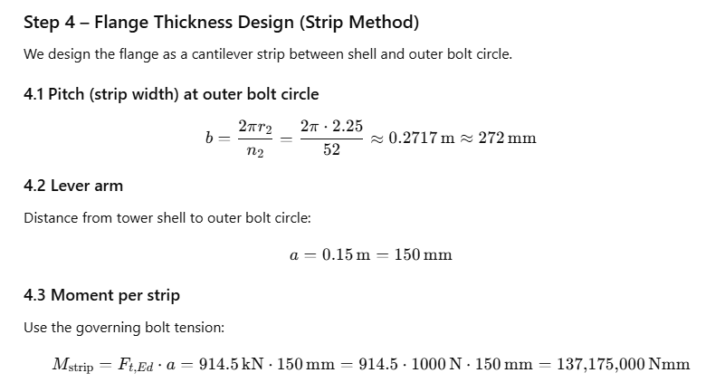
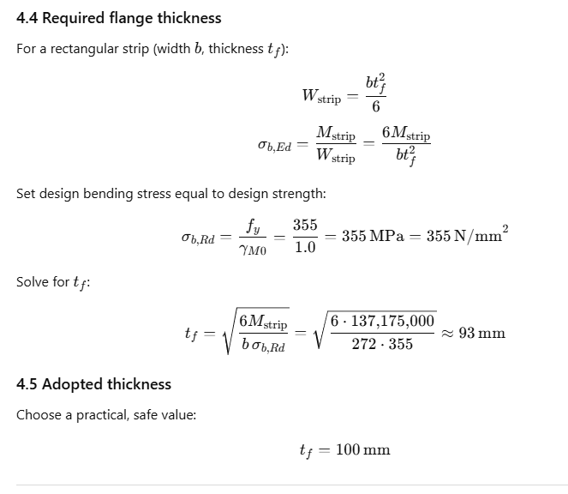
Design the flange connection
02/12/2025
10
Speaker: Ibrahim Mostafa (770134)
Tower structure team/ Optimus Syria

Slide 11
Design the flange connection
Joint | Flange Location | Bolt Size | Bolt Grade | Number of Bolts (total) | Flange Thickness
J1 | Base (20 m) | M48 | 10.9 HV | 92 | 100 mm
J2 | 40 m joint | M48 | 10.9 HV | 70 | 90 mm
J3 | 60 m joint | M48 | 10.9 HV | 48 | 80 mm
J4 | 80 m joint | M48 | 10.9 HV | 32 | 60 mm
J5 | Top joint | M48 | 10.9 HV | 32 | 60 mm
02/12/2025
11
Speaker: Ibrahim Mostafa (770134)
Tower structure team/ Optimus Syria

Slide 12
The next task
Design the door opening.
02/12/2025
12
Speaker: Ibrahim Mostafa (770134)
Tower structure team/ Optimus Syria

Slide 13
References
https://www.nrel.gov/wind/data-tools
02/12/2025
13
Speaker: Ibrahim Mostafa (770134)
Tower structure team/ Optimus Syria

